Slide 1
Fair Minimum Representation Clustering with Column Generation

Slide 2
Meeting Summary 02/02
Topics
Problem Formulation
Next Steps
Data generation (synthetic data) and experiments
Scaling
Visualization of solution in each iteration
How to deal with non-integer solutions? Fractional weights?
Use gurobi instead of cvxpy

Slide 3
Meeting Summary 02/09
Topics
Adjust Big M
Problems with bounds (gurobi continuous variables)
Gaussian mixture models
Next Steps
Warm-starting Master problem
Manipulate synthetic data to adjust the difficulty of clustering (dependence between clusters and labels?)

Slide 4
Meeting Notes 02/16
An issue with the pricing problem when the dual value for constraints (Z >= 0) or (Z <= 1) is non-zero
Consequence: Repetition of columns. The reduced cost of the pricing problem for that column would not go to zero.
See an example in the toy data
A linear program that solves the initial feasible solution for the master problem
Almost the same linear program in the Fair Minimum Representation Clustering paper, but the objective is a constant.
Non-integer decision variables in the master problem
Current solution: solve a MIP after termination
Problems: The solution is not good. Costly as well?

Slide 5
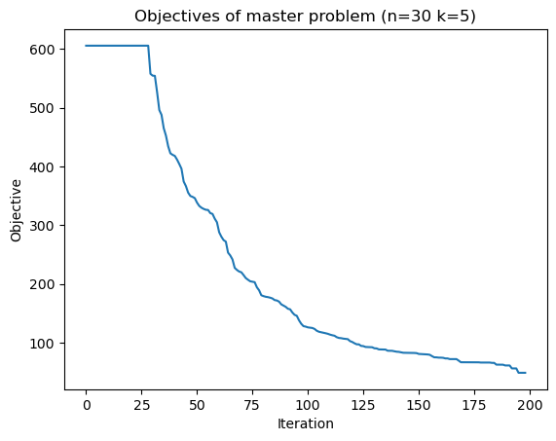
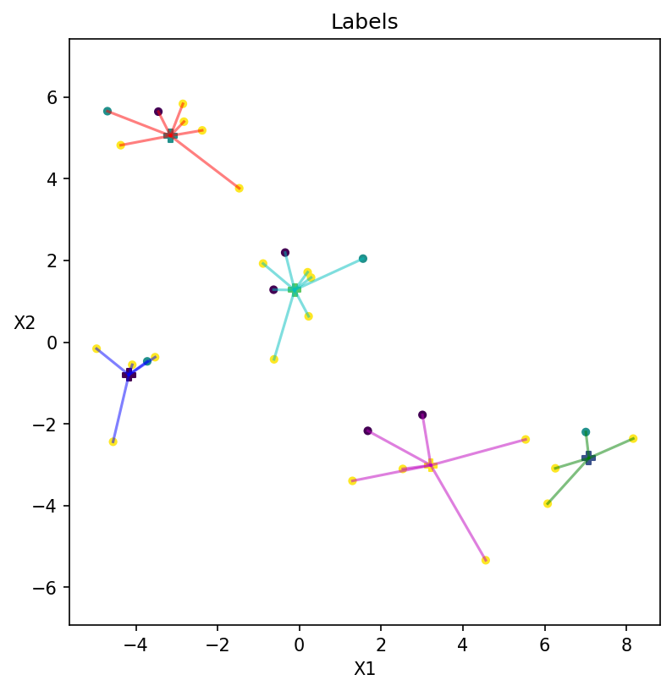
Experiment: n = 30, k = 5, beta = [1,1,0], Prob Dist= [0.1,0.2,0.7], alpha = 1/4 (Weak fairness constraints)

Slide 6
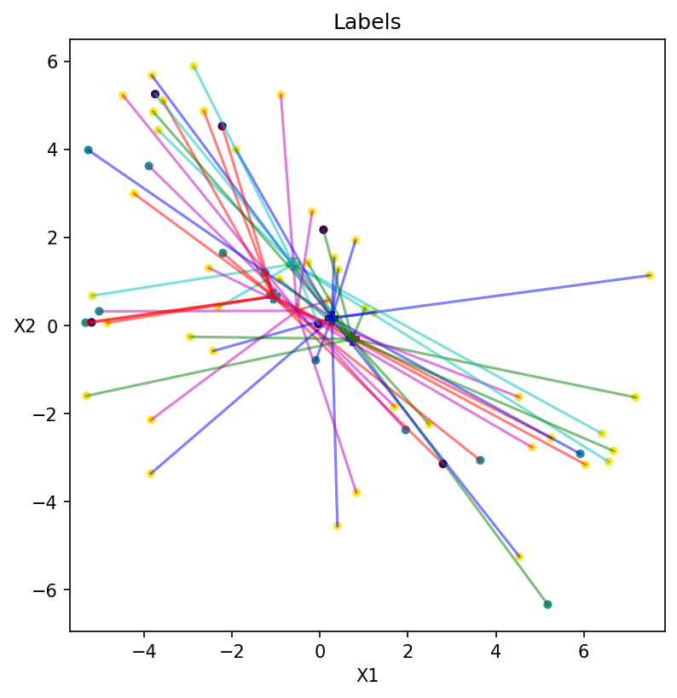
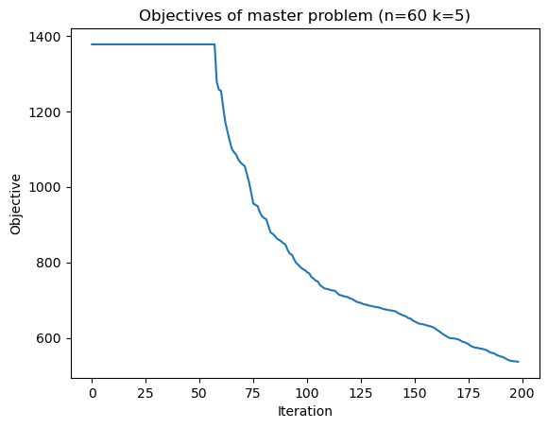
Experiment: n = 60, k = 5, beta = [1,1,0], Prob Dist= [0.1,0.2,0.7] , alpha = ¼ (Weak fairness constraints) The last MIP didn’t find a feasible solution except for the initial solution

Slide 7
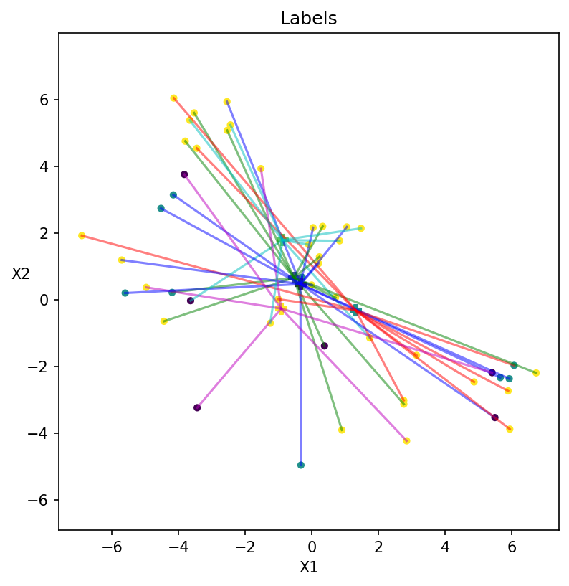
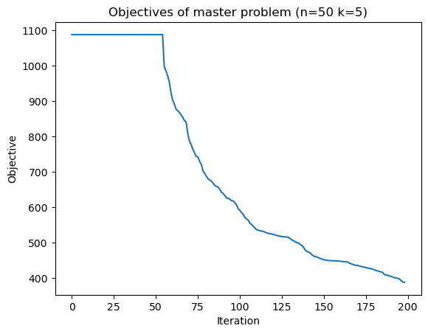
Experiment: n = 50, k = 5, beta = [1,1,1], Prob Dist= [0.1,0.2,0.7], alpha = ½ (Strong fairness constraints) The last MIP didn’t find a feasible solution except for the initial solution

Slide 8
Meeting Summary 02/16
Topics
Fix the issue with the pricing problem when the dual value for constraints Z <= 1 is non-zero
Relax the Z <= 1 constraint
Warm-starting the pricing problem
Observe that the constraints for the pricing problem don’t change across iterations. Use the previous solution as a feasible solution, adjust the objective.
Diving heuristics (LP Relaxation of the master problem does not give feasible solutions to the IP)
Deep dive strategies: fix 1 decision variable, filter out column candidates, and solve a new master + pricing problem with fewer variables
Branch and price and other potential strategies
Scaling and Synthetic data generation (“repliclust”)
Visualization (Clusters, Dual values, New columns)

Slide 9
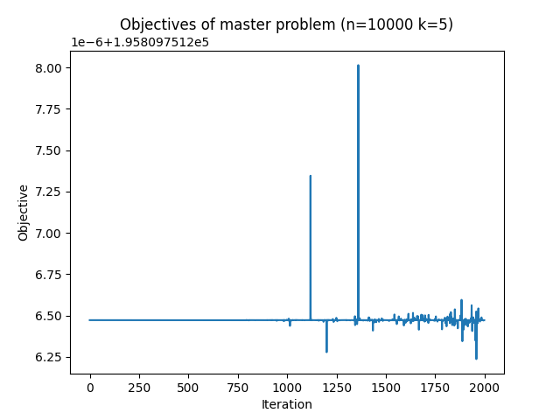
Meeting Notes 03/01
n = 10,000, k = 5, beta = [1,1,1], Prob Dist= [0.1,0.2,0.7], alpha = ½, 2000 iterations. (~11 hours)

Slide 10
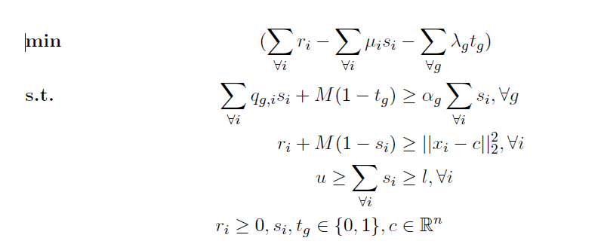
Meeting Notes 03/01
In the pricing problem, when lambda_g =0, t_g may not correctly encode whether the cluster is alpha-rep for group g.
Fix: recalculate t_g after it returns a solution.

Slide 11
Nodes | Current Node | Objective Bounds | Work
Expl Unexpl | Obj Depth IntInf | Incumbent BestBd Gap | It/Node Time
H2168780 1669564 -34298.47879 -34650.848 1.03% 14.3 430s
2189877 1685513 -34431.290 41 89 -34298.479 -34650.285 1.03% 14.3 435s
2214391 1703377 -34303.536 78 52 -34298.479 -34649.638 1.02% 14.3 440s
2238649 1721219 -34420.711 66 62 -34298.479 -34648.944 1.02% 14.3 445s
2261575 1737999 -34532.622 48 83 -34298.479 -34648.371 1.02% 14.4 450s
2287111 1756860 -34492.789 52 76 -34298.479 -34647.664 1.02% 14.4 455s
2311588 1774540 -34361.512 68 61 -34298.479 -34646.963 1.02% 14.4 460s
2335812 1792491 -34324.936 79 51 -34298.479 -34646.352 1.01% 14.4 465s
2361389 1811297 -34526.041 33 93 -34298.479 -34645.649 1.01% 14.4 470s
2385563 1829097 -34439.927 58 71 -34298.479 -34645.010 1.01% 14.4 475s
2411185 1847802 -34531.661 49 80 -34298.479 -34644.323 1.01% 14.4 480s
2435722 1865541 -34328.974 79 51 -34298.479 -34643.723 1.01% 14.4 485s
2461041 1884477 -34431.597 58 72 -34298.479 -34643.047 1.00% 14.4 490s
2485580 1902531 -34440.116 54 74 -34298.479 -34642.409 1.00% 14.4 495s
2511000 1920173 -34527.945 45 84 -34298.479 -34641.816 1.00% 14.4 500s
Cutting planes:
Gomory: 67
MIR: 148
Flow cover: 117
Inf proof: 36
RLT: 1
Relax-and-lift: 12
Explored 2511106 nodes (36190875 simplex iterations) in 500.01 seconds (229.83 work units)
Thread count was 8 (of 8 available processors)
Solution count 10: -34298.5 -34296 -34272.5 ... -34152.9
Time limit reached
Best objective -3.429847879461e+04, best bound -3.464181575111e+04, gap 1.0010%
Objective: -34298.478794611336
Setting a time limit for the pricing problem (500s)
terminate early?

Slide 12
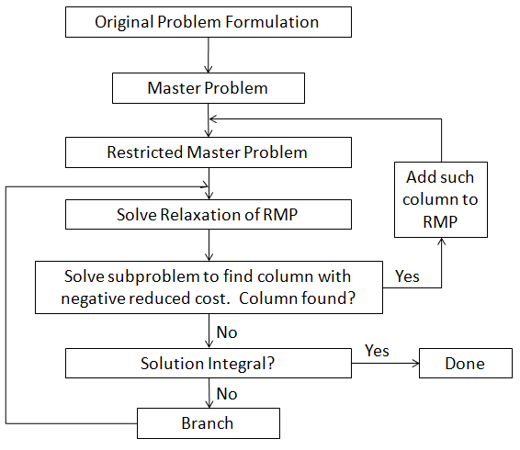
Branching
which variable to branch on
strong branching
Node selection
best estimate criterion (DFS) until infeasible/integral
Cut pool
Preprocessing
…
branch and price (and cut?)

Slide 13
Meeting Summary 03/01
Problems with the plateau
Reasons why this plateau occurs and increases as n,k goes up
Explore adding slacking variables and penalties to master problems to give some flexibility when there aren’t enough columns
Strategically generate new columns in the pricing problem to fill in the gaps
Add more columns with negative reduced costs in the pricing problem
Use Gurobi’s good solutions
Fix the logging issue and do more tests with smaller n
Visualize new clusters

Slide 14
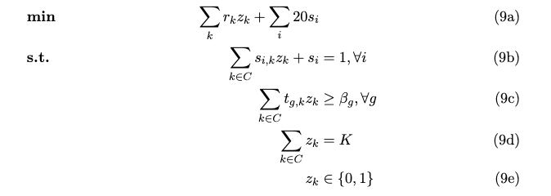
Meeting Notes 03/08
Generate 10 good solutions (clusters) from the pricing problem in each iteration
For solutions that are not optimal, recalculate distances to find accurates cost for each cluster
Add slack variables to the master problem:

Slide 15
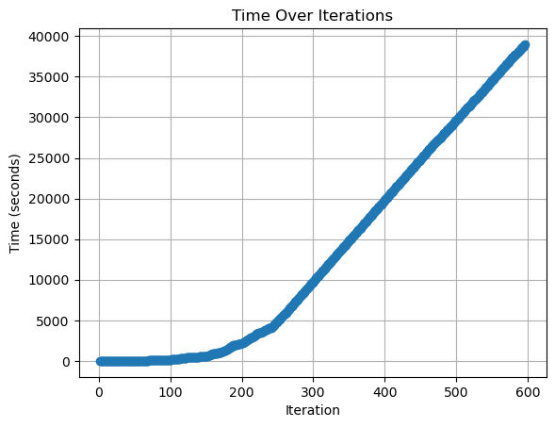
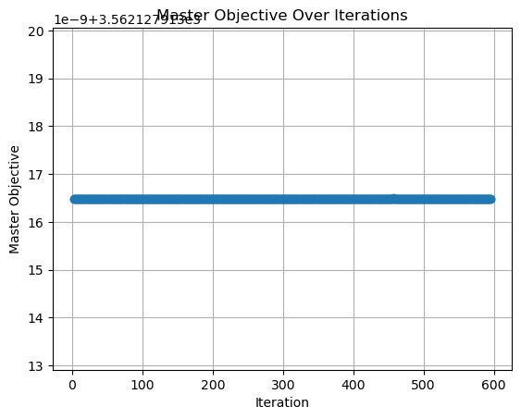
Experiment: n = 200, k = 5, beta = [1,1,1], Prob Dist= [0.1,0.2,0.7], alpha = ½. (Vanilla version without multiple solutions or slack variables)
100s Time limit imposed

Slide 16
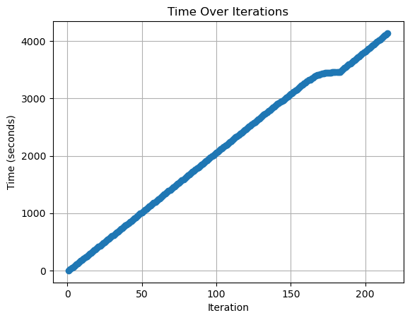
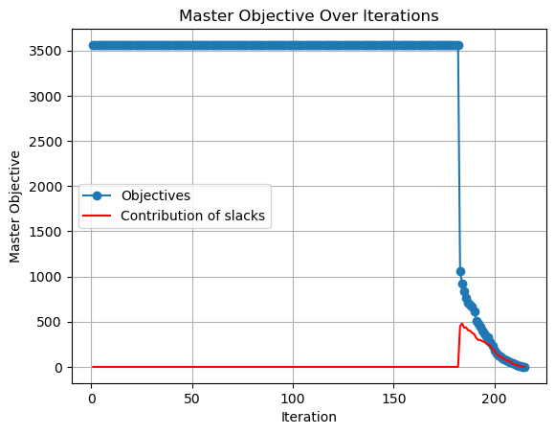
Experiment: n = 200, k = 5, beta = [1,1,1], Prob Dist= [0.1,0.2,0.7], alpha = ½. (10 New Clusters from Column Generation per iteration, Slack variables introduced)
20s Time limit imposed

Slide 17
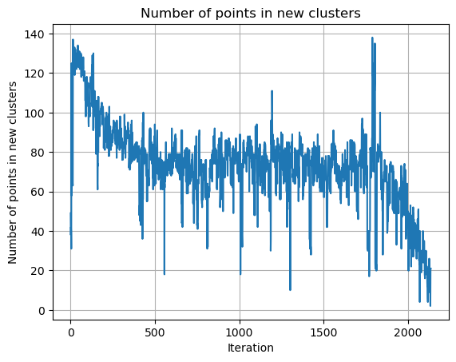
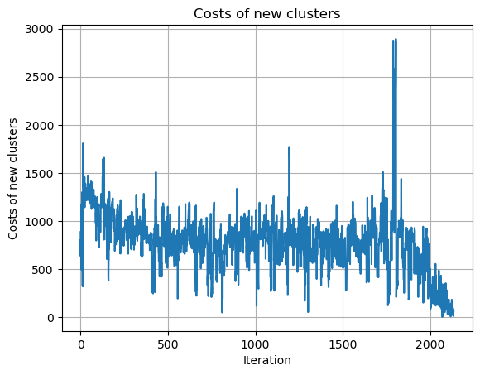
Experiment: n = 200, k = 5, beta = [1,1,1], Prob Dist= [0.1,0.2,0.7], alpha = ½. (10 New Clusters from Column Generation per iteration, Slack variables introduced)

Slide 18
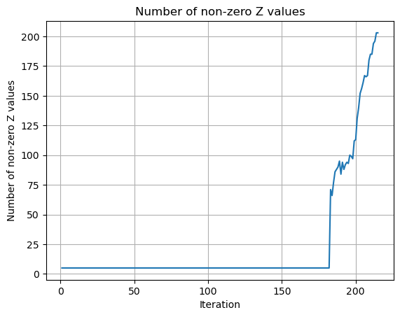
Experiment: n = 200, k = 5, beta = [1,1,1], Prob Dist= [0.1,0.2,0.7], alpha = ½. (10 New Clusters from Column Generation per iteration, Slack variables introduced)

Slide 19
Meeting Summary 03/08
Debugging - solve LP, column generation
Add slack variables to alpha representation problems

Slide 20
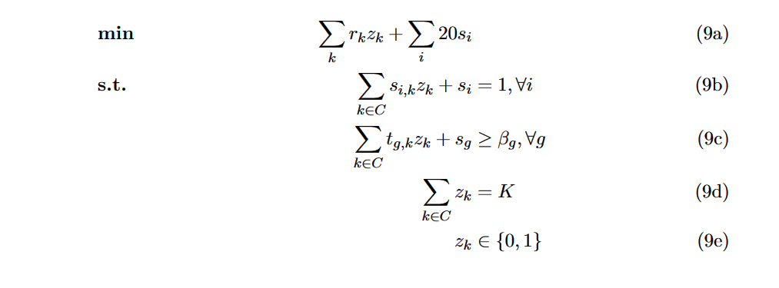
Meeting Notes 03/18
Bug fixes: master objective not updated correctly during warm start when adding multiple new columns. (model.getObjective() is not refreshed until a new optimization is executed)
Slack variables added to feasibility and fairness constraints.

Slide 21
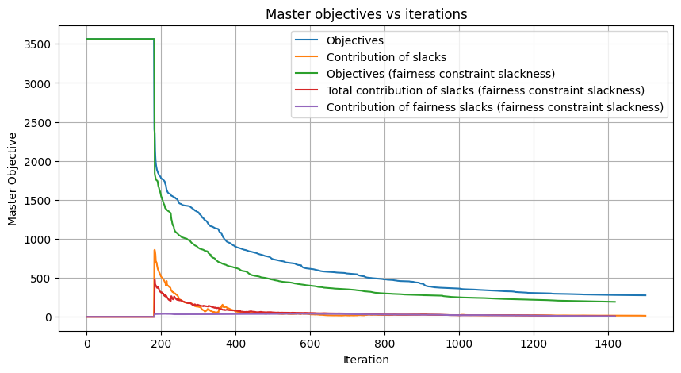
Experiment: n = 200, k = 5, beta = [1,1,1], Prob Dist= [0.1,0.2,0.7], alpha = ½. Slack variables added to feasibility constraints (and fairness constraints).

Slide 22
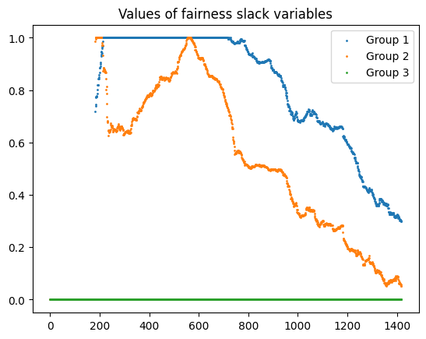
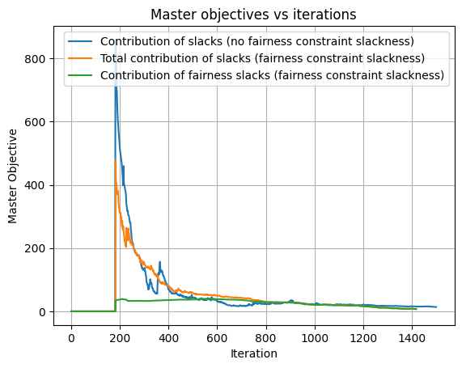
Experiment: n = 200, k = 5, beta = [1,1,1], Prob Dist= [0.1,0.2,0.7], alpha = ½. Slack variables added to feasibility constraints (and fairness constraints).

Slide 23
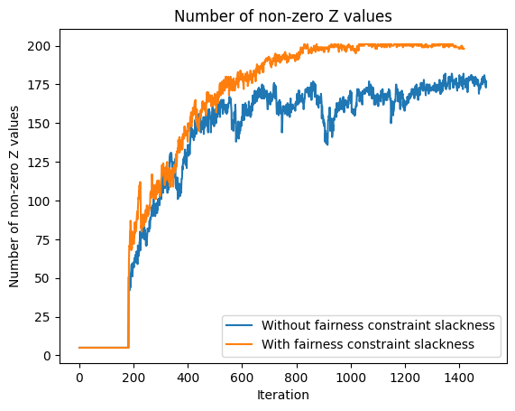
Experiment: n = 200, k = 5, beta = [1,1,1], Prob Dist= [0.1,0.2,0.7], alpha = ½. Slack variables added to feasibility constraints (and fairness constraints).

Slide 24
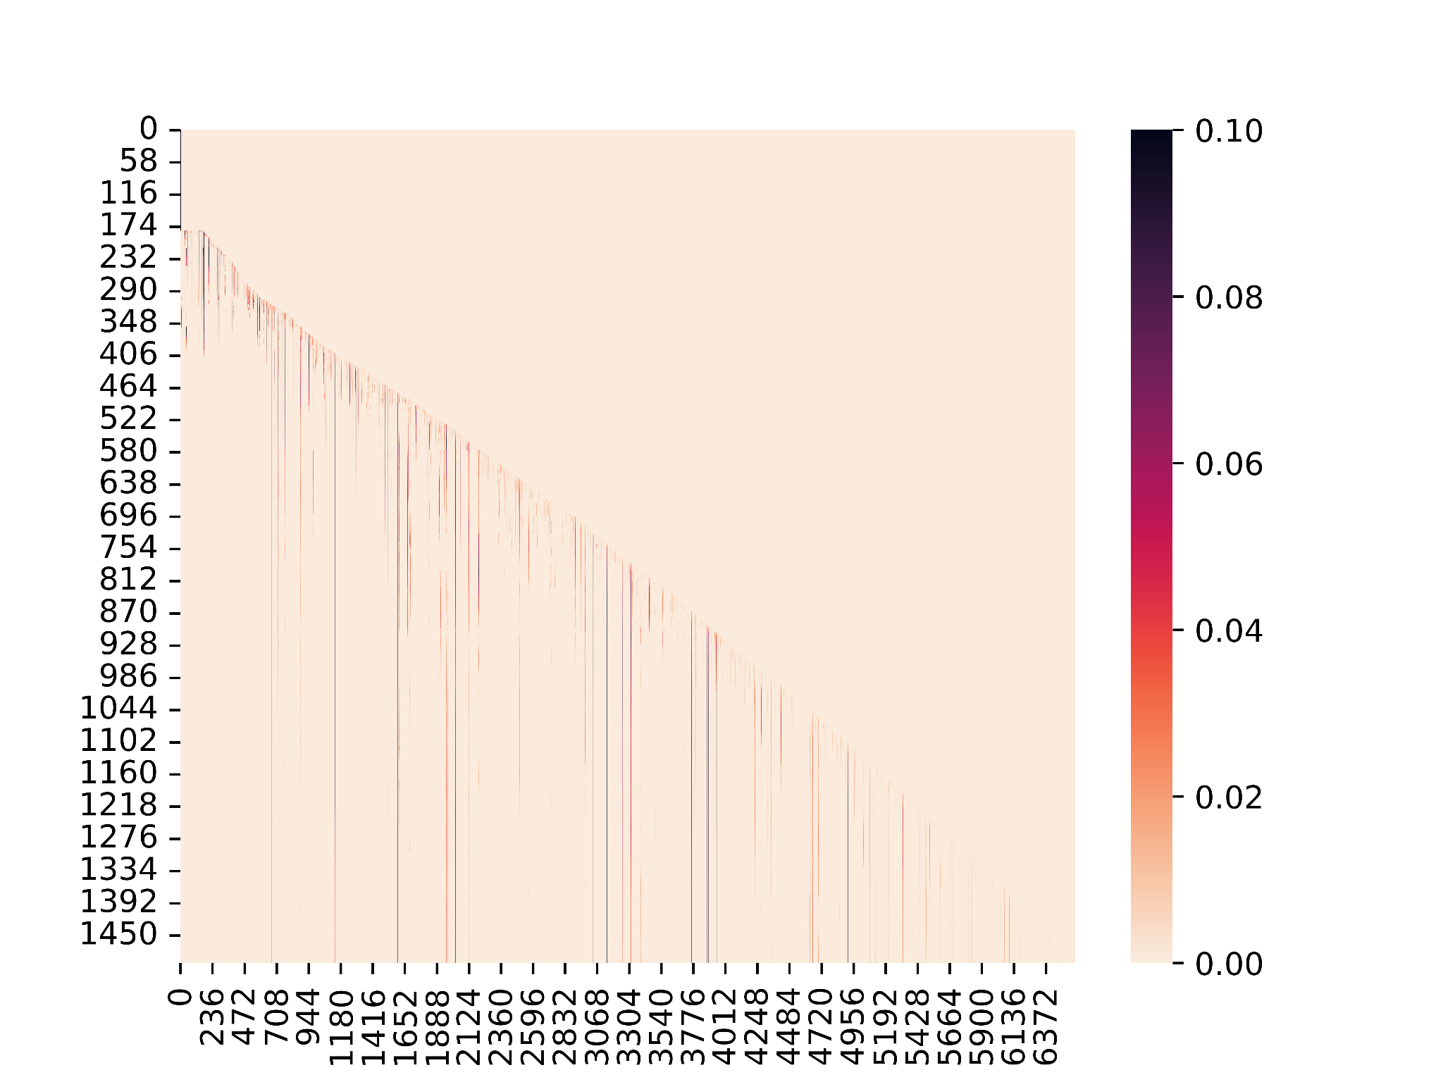
Experiment: n = 200, k = 5, beta = [1,1,1], Prob Dist= [0.1,0.2,0.7], alpha = ½. Slack variables added to feasibility constraints only.
Trajectories are reduced: Only column used at least once (corresponding variable > 0) is plotted.
6587 columns used among 14698 columns (44.8%)

Slide 25
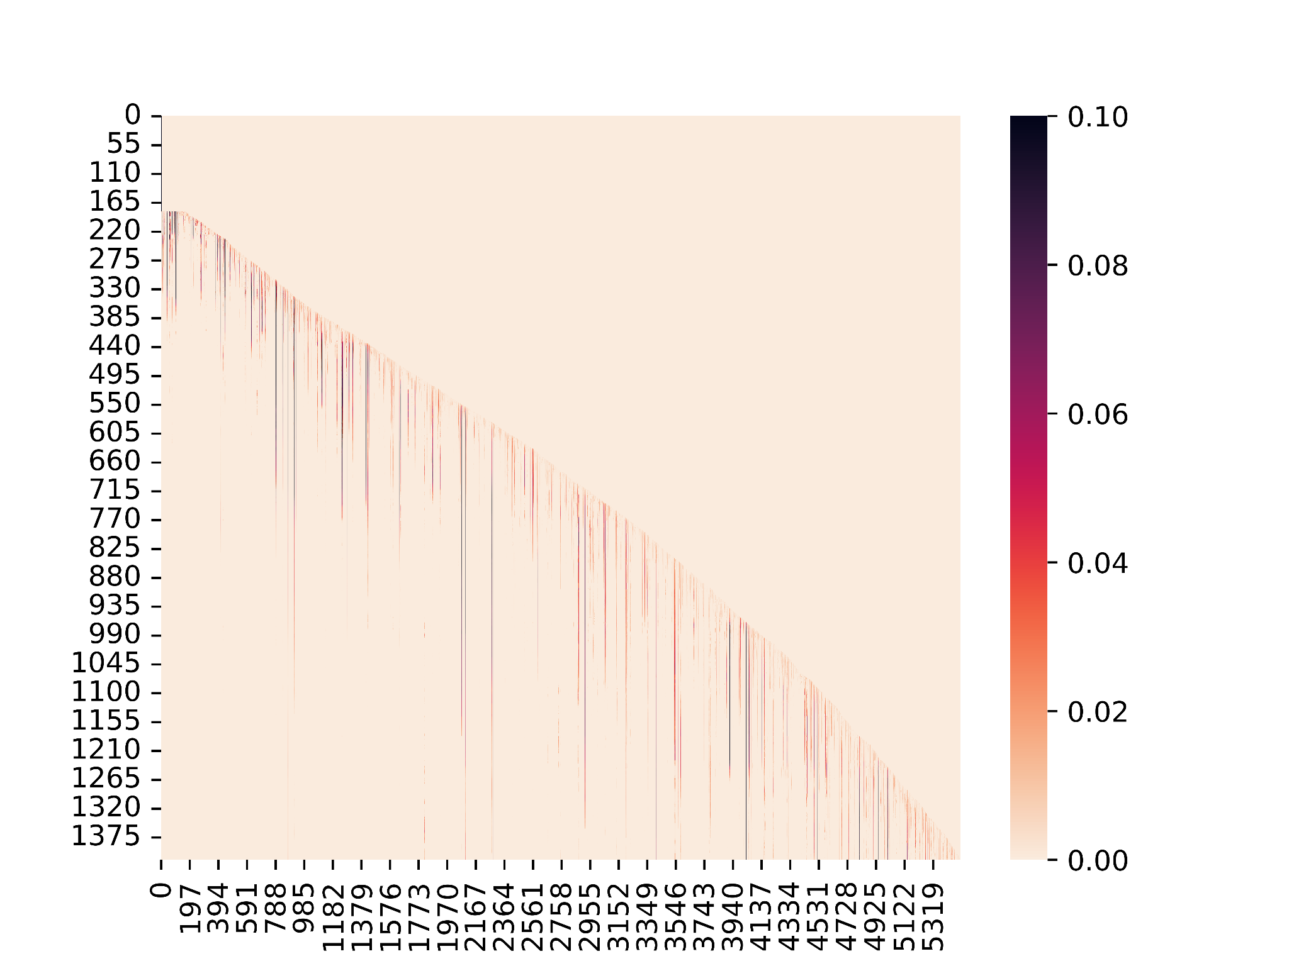
Experiment: n = 200, k = 5, beta = [1,1,1], Prob Dist= [0.1,0.2,0.7], alpha = ½. Slack variables added to feasibility and fairness constraints.
Trajectories are reduced: Only column used at least once (corresponding variable > 0) is plotted.
5507 columns used among 13945 columns (39.5%)

Slide 26
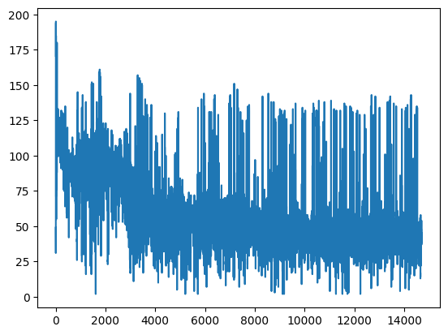

Slide 27
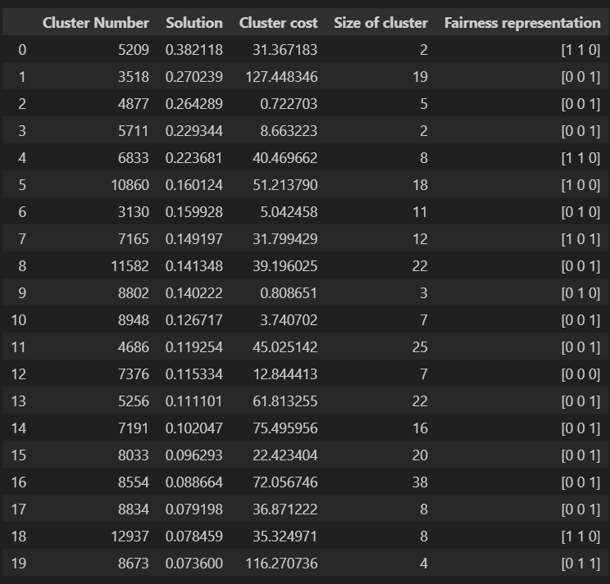
Slack variables added to feasibility constraints only.
Top 20 clusters in the last iteration (clusters with the highest z_i weights)

Slide 28
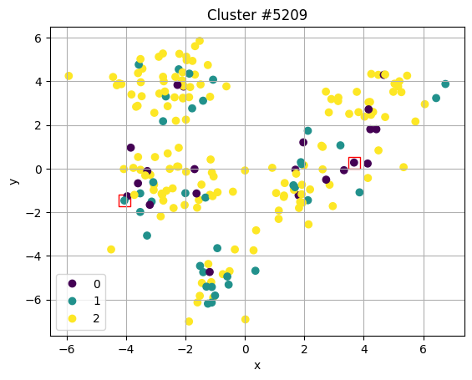
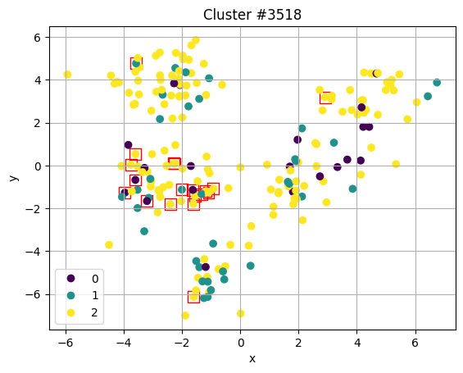
Experiment: n = 200, k = 5, beta = [1,1,1], Prob Dist= [0.1,0.2,0.7], alpha = ½. Slack variables added to feasibility constraints only.

Slide 29
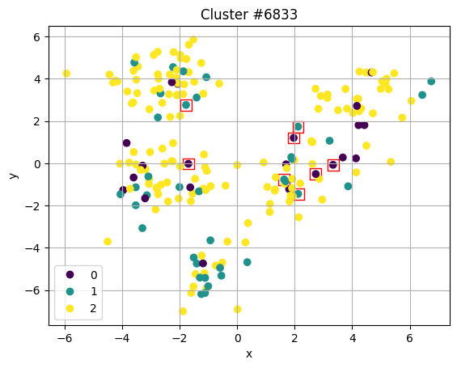
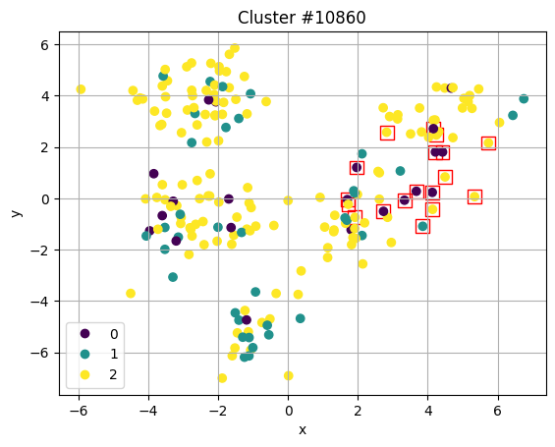
Experiment: n = 200, k = 5, beta = [1,1,1], Prob Dist= [0.1,0.2,0.7], alpha = ½. Slack variables added to feasibility constraints only.

Slide 30
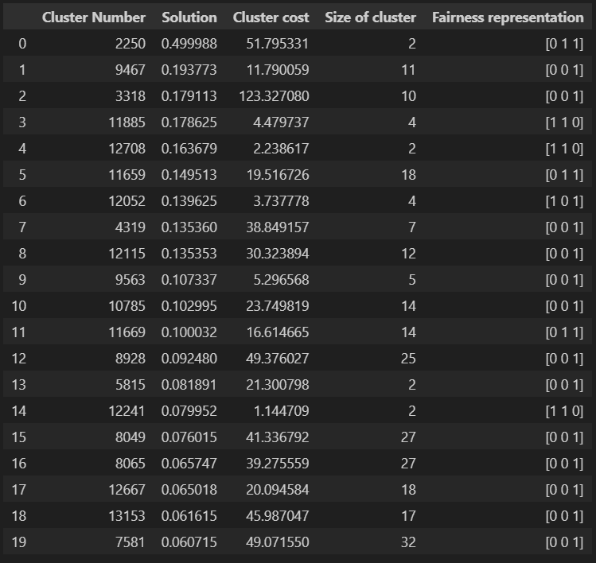
Slack variables added to feasibility and fairness constraints.
Top 20 clusters in the last iteration (clusters with the highest z_i weights)

Slide 31
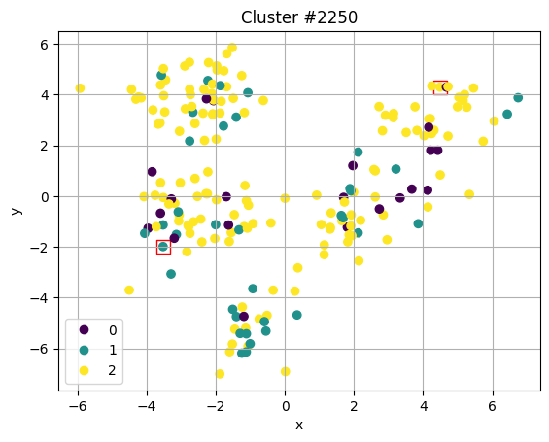
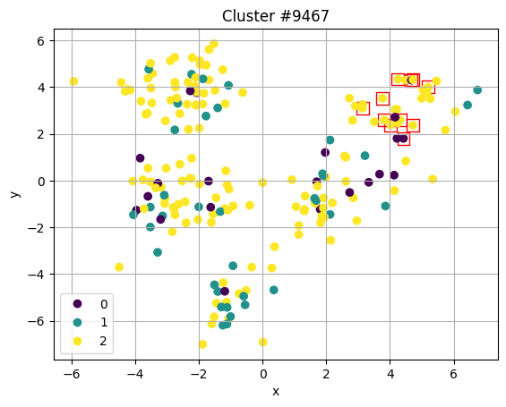
Experiment: n = 200, k = 5, beta = [1,1,1], Prob Dist= [0.1,0.2,0.7], alpha = ½. Slack variables added to feasibility and fairness constraints.

Slide 32
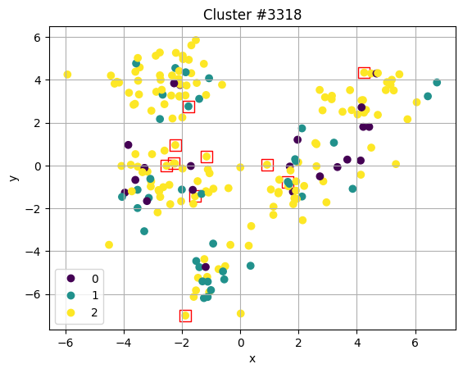
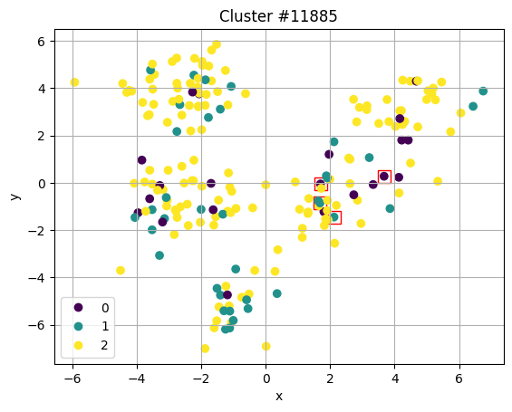
Experiment: n = 200, k = 5, beta = [1,1,1], Prob Dist= [0.1,0.2,0.7], alpha = ½. Slack variables added to feasibility and fairness constraints.

